Slide 1


Natural Language Processing using Machine Learning
Pnina Vetcher and Itai Blatnoy – Final Project
NAYA college
Practical Data Science
July 2020

Slide 2
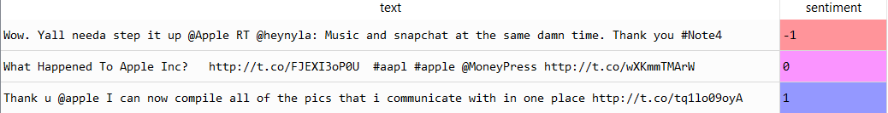
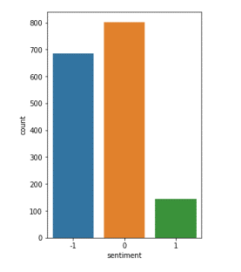
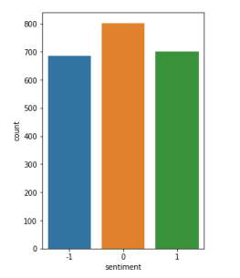

The Data
1,630 Apple related tagged tweets in English
Sentiment Classes:
Positive (1)
Negative (-1)
Neutral (0)
Imbalanced data
Resolved using oversampling

Slide 3
Sentiment Classification
Data Cleaning &
Feature Engineering
Models
Vectorization
Apple Data
Manual Cleaning
Multinomial Naive Bayes Classifier (MNB)
Support Vector Machine (SVM)
Logistic Regression
Recurrent Neural Networks (RNN)
Bag of Words
TF-IDF
Spacy Methods
Word Embedding Word2vec

Slide 4

Data Cleaning & Feature Engineering Dimension Reduction
Manual
Cleaning
Spacy
Methods
Lower Casing
Abbreviations
Tagging Words
Curses
Apple
Zero
URLs
Hashtags
Tokenization
Lemmatization
Stop Words

Slide 5
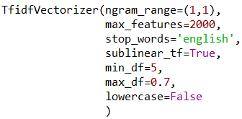
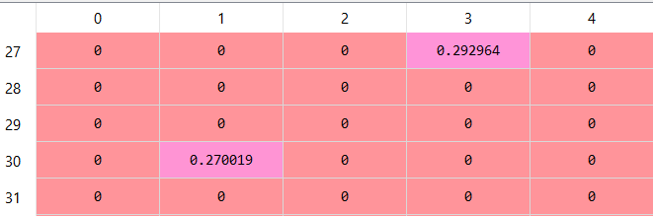
Bag of Words - TF-IDF
Vectorization using TF-IDF

Slide 6
Bag of Words Models
Multinomial Naive Bayes Classifier(MNB)
clf = MultinomialNB(alpha=0.1, fit_prior=True, class_prior=None)
MultinomialNB: 0.831
naive_bayes_gs = GridSearchCV(naive_bayes_model, my_param_grid, cv=k)
MultinomialNB - accuracy: 0.838
Support Vector Machine (SVM)
clf= svm.SVC(kernel='linear', C=1, gamma=1)
svm.SVC: 0.860
Logistic Regression
Logistic_Regression = LogisticRegression(C=0.1)
my_param_grid = [{ "C": [0.8, 1, 1.2, 1.4]}]
k = 5
logistic_regression_gs = GridSearchCV(Logistic_Regression,
my_param_grid, cv=k)
Logistic_regression best parameters: {'C': 1.2}
Logistic_regression train score: 0.935
Logistic_regression test score: 0.867

Slide 7

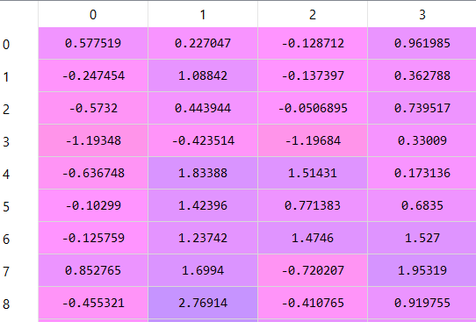
Word Embedding - Word2vec
word2vec_model = gensim.models.Word2Vec(my_documents,
size=100,
min_count=1,
window=5,
iter=100)

Slide 8
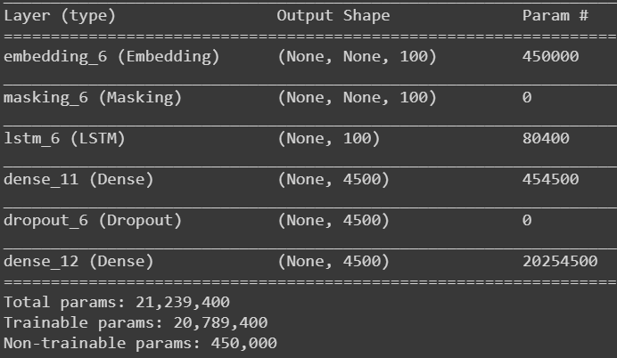
Recurrent Neural Networks (RNN)

Slide 9

THANK YOU
Pnina Vetcher
Itai Blatnoy
pnina.vetcher@gmail.com
blatnoyitai@gmail.com

